Slide 1
Chapter 4
ORGANIZATIONAL CULTURE

Slide 2
4.1
Define what organizational culture is and explain why it’s important.

Slide 3
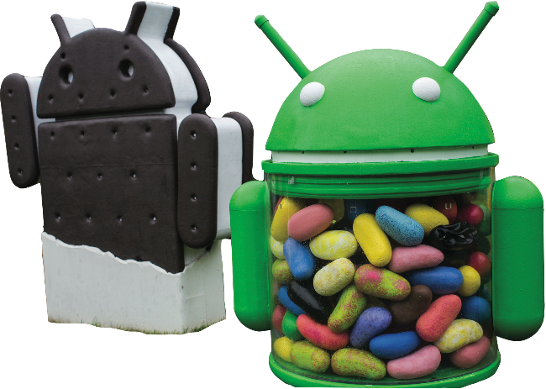
What is Organizational Culture?
Each of us has a unique personality that influences the way we act and interact. An organization has a personality too—we call it CULTURE.

Slide 4
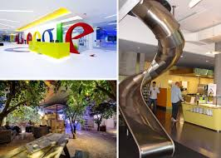


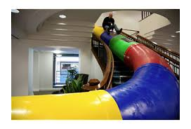
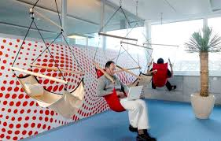
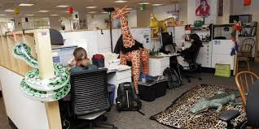

Google has creative and innovative culture

Slide 5
Organizational Culture
Shared values
Principles
Traditions
and ways of doing things that influence the
way an organization’s members act.
Notes:
Organizational culture has been described as the shared values, principles, traditions, and ways of doing things that influence the way organizational members act.

Slide 6
Culture is:
Perceived
It is not something that can be seen or physically touched.
But employees perceive it on the basis of what they experience within the organization
Descriptive
It is concerned with how members perceive or describe the culture, not with whether they like it
Shared
Even though individuals may have different backgrounds or work at different levels, they tend to describe the organization’s in similar terms.
Notes:
1. Culture is perceived. It’s not something that can be physically touched or seen, but employees perceive it on the basis of what they experience within the organization.
2. Culture is descriptive. It’s concerned with how members perceive or describe the culture, not with whether they like it.
3. Culture is shared. Even though individuals may have different backgrounds or work at different organizational levels, they tend to describe the organization’s culture in similar terms.

Slide 7
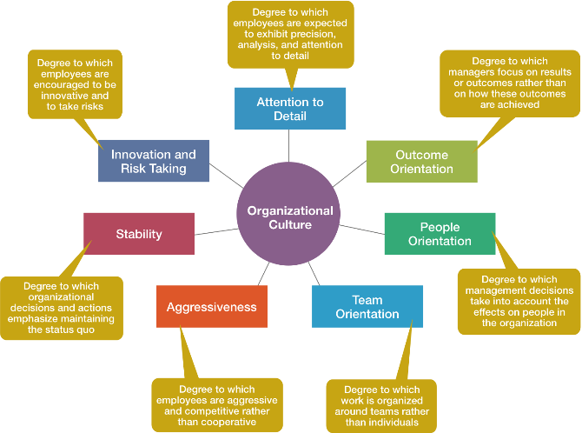
Dimensions of Culture
Notes:
These seven dimensions shown in Exhibit 2–4:
• Range from low (not typical of the culture) to high (especially typical of the culture).
• Provide a composite picture of the organization’s culture.
• May emphasize one cultural dimension more than the others, essentially shaping the organization’s personality and the way organizational members work.
—

Slide 8
How can culture be described?
Seven dimensions
Range from low (not typical of the culture) to high (especially typical of the culture)
Provide a composite picture of the organization’s culture
May emphasize one cultural dimension more than the others, essentially shaping the organization’s personality and the way organizational members work

Slide 9
Sony Corporation—focus is product innovation (innovation and risk taking). The company “lives and breathes” new product development and employees’ work behaviors support that goal.
Southwest Airlines has made its employees a central part of its culture (people orientation) and shows this through the way it treats them.

Slide 10


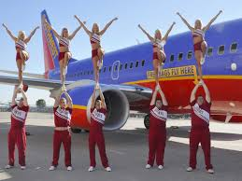



Slide 11
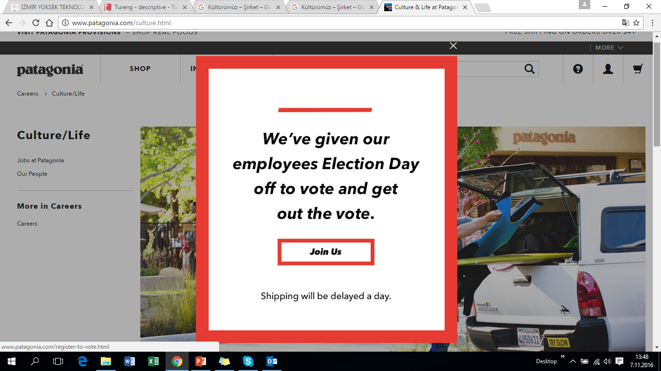

Slide 12
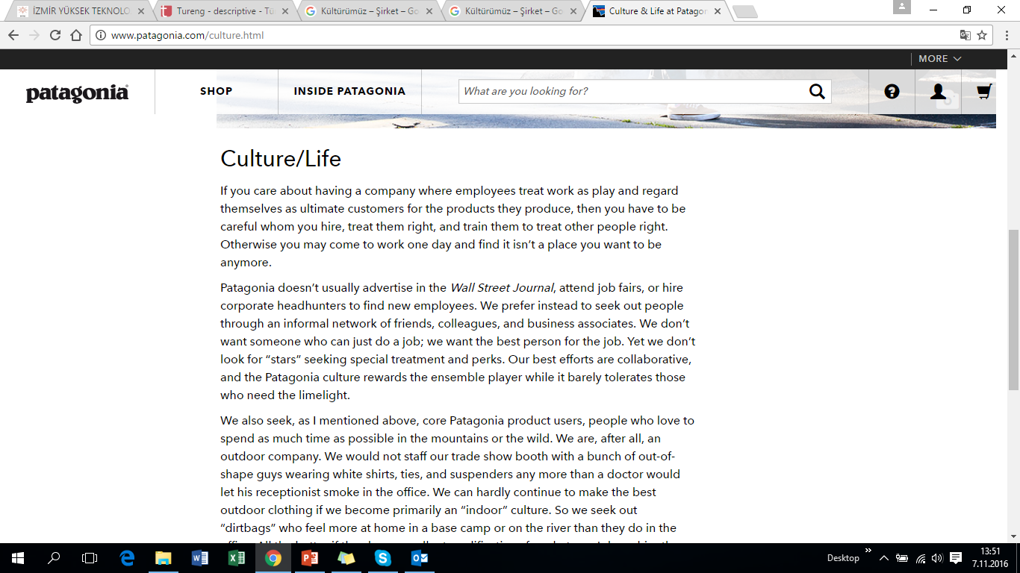
http://www.patagonia.com/culture.html

Slide 13
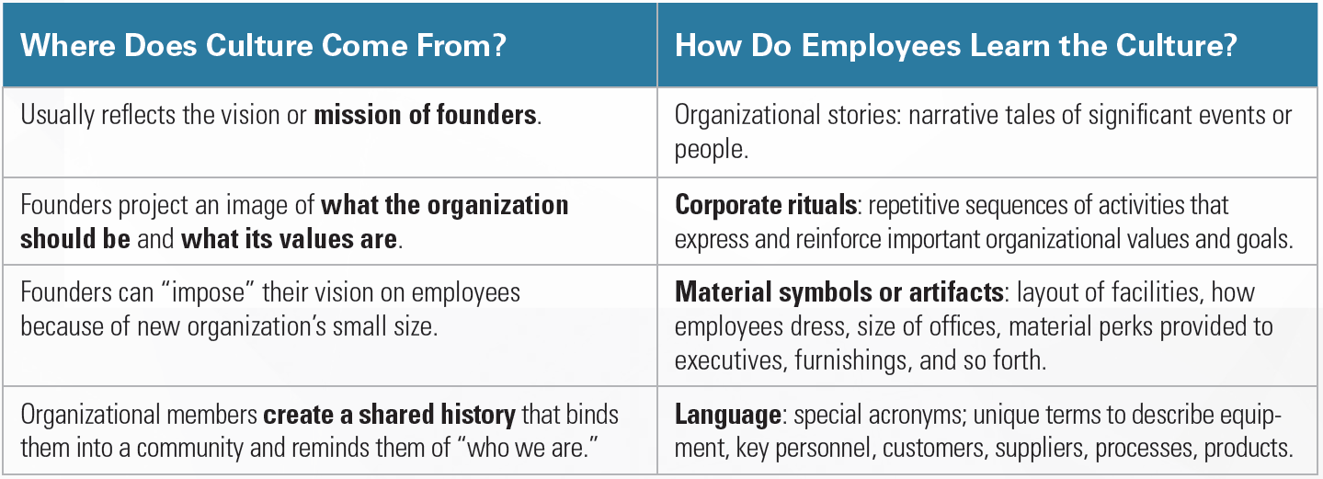
Employees most commonly learn an organization’s culture through its stories, rituals, material symbols, and language.
Notes:
An organization’s culture generally reflects the vision or mission of its founders, who establish the early culture by projecting an image of what the organization should be and what its values are.
Employees most commonly learn an organization’s culture through its stories, rituals, material symbols, and language.

Slide 14
4.2
Describe how organizational culture affects managers.

Slide 15
How Does Organizational Culture Affect Managers
Organizational culture affects managers in two primary ways:
Through its effect on what employees do and how they behave
Through its effect on what managers do as they plan, organize, lead, and control.
Notes:
Organizational culture affects managers in two primary ways:
Through its effect on what employees do and how they behave, and
Through its effect on what managers do as they plan, organize, lead, and control.

Slide 16


Marjorie Kaplan, president of the Animal Planet and Science television networks, describes how the power of organizational culture affects her as a manager.
She says that one of her company’s stated goals is “to make it the place where, when you come to work, you feel like you have the opportunity to bring your best self—and you’re also challenged to bring your best self.”

Slide 17
How Does Culture Affect What Employees Do?
An organization’s culture has an effect on what employees do, depending on how strong, or weak, the culture is.
Strong cultures:
cultures in which the key values are deeply held and widely shared- have a greater influence on employees than do weaker cultures.

Slide 18
How Does Culture Affect What Employees Do?
The more employees accept the organization’s key values and the greater their commitment to those values, the stronger the culture is.

Slide 19
In organization with a strong culture, that culture can substitute for the rules and regulations that formally guide employees.
Stronger an organization’s culture – less formal rules and regulations – guides are internalized in employees
In organization with a weak culture, no dominant shared values are present- its effect on employee behavior is less clear

Slide 20
Strong Cultures Can:
Substitute for formal rules and regulations
Create predictability, orderliness, and consistency
Notes:
The stronger an organization’s culture, the less managers need to be concerned with developing formal rules and regulations. Instead, those guides will be internalized in employees when they accept the organization’s culture.
If, on the other hand, an organization’s culture is weak—if no dominant shared values are present— its effect on employee behavior is less clear.

Slide 21
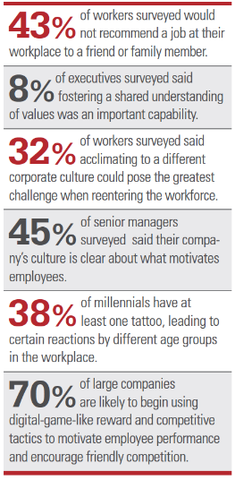
Acclimating to Corporate Culture
In a recent survey of management and employees that reflects changes in both internal and external organizational environments,
Notes:
In a recent survey of management and employees that reflects changes in both internal and external organizational environments, 32 percent of workers surveyed said that acclimating to a different corporate culture could pose the greatest challenge when reentering the workforce.

Slide 22

How Does Culture Affect What Managers Do?
Mattel’s culture of play reflects the toymaker’s value of positive impact on children’s lives by creating products that foster the joy of play and by involving managers and employees in volunteer programs that help kids.

Slide 23
Because an organization’s culture constrains what they can and cannot do and how they manage, it’s particularly relevant to managers.
Such constraints are rarely explicit. They’re not written down. It’s unlikely they’ll even be spoken. But they’re there, and all managers quickly learn what to do and not do in their organization.
For instance, you won’t find the following values written down, but each comes from a real organization:
Look busy even if you’re not.
• If you take risks and fail around here, you’ll pay dearly for it.
• Before you make a decision, run it by your boss so that he or she is never surprised.
• We make our product only as good as the competition forces us to.
• What made us successful in the past will make us successful in the future.
• If you want to get to the top here, you have to be a team player

Slide 24
Company Values Affect Managers’ Behavior
“Ready-aim-fire” versus “Ready-fire-aim”
“ready-aim-fire” culture; In such an organization, managers will study and analyze proposed projects endlessly before committing to them.
However, in a “ready-fire-aim” culture, managers take action and then analyze what has been done.

Slide 25
If an organization’s culture supports the belief that profits can be increased by cost cutting and that the company’s best interests are achieved slow but steady increases in quarterly earnings.
Managers are unlikely to pursue programs that are innovative, risky, long term or expansionary.
In an organization whose culture has distrust of employees, managers are more likely to use an authoritarian leadership style than a democratic one.

Slide 26
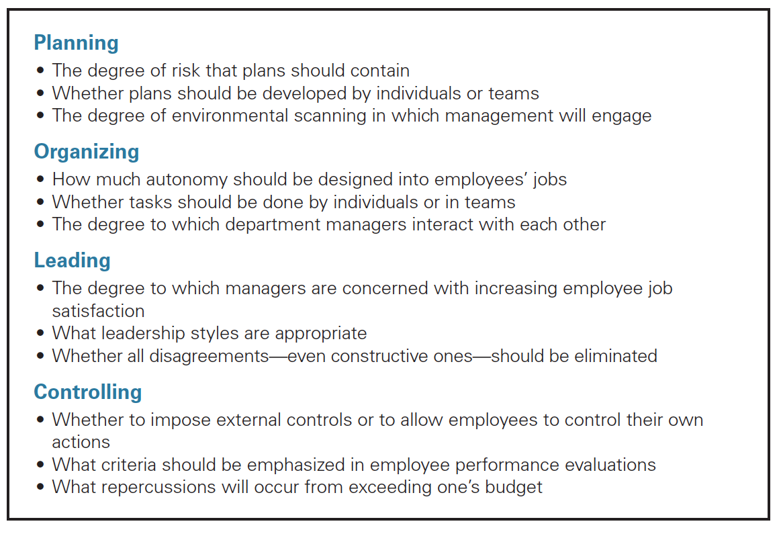
Managerial Decisions Influenced by Culture
A manager’s decisions are influenced by the culture in which he or she operates. An organization’s culture, especially a strong one, influences and constrains the way managers plan, organize, lead, and control.

Slide 27
The culture influences managerial planning about the degree of risk that plans should contain, whether plans should be developed by individuals or teams, or the amount of environmental scanning in which management will engage.
Organizing activities; culture influences how much autonomy should be designed into employees’ jobs, whether tasks should be done by individuals or in teams, and the degree to which department managers interact with each other.

Slide 28
Leading, organization culture helps determine the degree to which managers try to increase employee job satisfaction, appropriate leadership styles, and whether all disagreements—even constructive ones—should be eliminated.
Controlling activities: for example, whether they impose external controls or to allow employees to control their own actions, which criteria should be emphasized in employee performance evaluations.

